Slide 1
Curriculum Framework for Children and Young People with Vision Impairment (CFVI): Core Training Resource 1 An Overview of the Curriculum Framework
Notes:
Speaker notes
Introductions as appropriate to the session.
This presentation is one of 12 training resources related to the CFVI and focuses on providing a comprehensive introduction and overview of the complete framework.

Slide 2
Project Partners
There are 4 partner organisations involved in the CFVI project.
The production of these training/continuing professional development materials was led by VIEW (The Professional Association for the Vision Impairment Education Workforce), in association with a consultation group of stakeholders working in the field of VI Education.
Notes:
Speaker notes
There are 4 partner organisations involved in the CFVI project (refer to the logos at the bottom of the slide).
Optional background: (see also p.34 of CFVI)
The project was funded by the Royal National Institute of Blind People [RNIB].
The Vision Impairment Centre of Teaching and Research – VICTAR – consulted with professionals working in the field, parents and children and young people to inform the writing of the CFVI; they are also involved in the evaluation of the CFVI in practice.
The Professional Association for the Vision Impairment Workforce – VIEW – was involved in working to secure resources for the resource hub and in devising this training.
Thomas Pocklington Trust (TPT), is a national charity which supports blind and partially sighted people with a focus on Education, Employment and Engagement, providing guidance and advice. In Phase 2 of the project TPT will be working on influencing educational policy.
Different aspects of the project are led by different project partners. The production of the training/CPD materials was led by VIEW in association with a consultation group of key stakeholders who work in the field of VI Education.

Slide 3
Training Objectives
The objectives of this training resource are to:
an introduction to the CFVI to show why it was developed, who it is intended to be used with and how it can be helpful to a range of stakeholders.
an overview of the wide range of resources that have been collated to support implementation of the CFVI in educational practice.
some links to useful resources/websites.
Notes:
Speaker notes
Run through the core training objectives on this slide.
You should also mention the need for collaborative working in the delivery of the CFVI, lead by specialists in VI education, and stress the importance of involving the child/young person to whatever extent is possible, members of the family as well as the other key stakeholders.

Slide 4
What is the CFVI?
A curriculum framework developed for children and young people with vision impairment:
Details outcomes/interventions in 11 areas​.
Captures the distinctive skills needed by children and young people (0-25) with a vision impairment (CYP with VI) that promote access and an equitable education.
For those of school age the intention is that the framework should be closely integrated with the curriculum of the school/setting.
“Although [these 11 areas] are described as discrete areas, it should be stressed that in practice they are often linked and mutually reinforcing.” (McLinden, M et al, 2022 p.165).
Notes:
Speaker notes
Key points in addition to slide content:
Developed as part of a multiagency project and wide consultation with professionals in the field of VI education, parents and young people.
Launched in UK in March 2022.
Important to emphasise bullet point 3: it is not a separate curriculum, but should be integrated with the school’s curriculum (mainstream/special). So joint working/planning/reinforcement of the skills in the classroom are of vital importance.
Important to emphasise bullet point 2: the age range that the curriculum covers.

Slide 5
Why was the CFVI developed? (1)
To aid discussions and understanding amongst all involved in a child/young person’s education of how and when these skills should be taught by suitably qualified specialists and reinforced by non-specialists.
“The framework is not intended to provide the detail of how to deliver outcomes as this, along with resource allocation, remains at the discretion of the service or professional working with the child/young person.”
(CFVI 2022, p.10)​.
Notes:
Speaker notes
Key points in addition to slide 5 + 6 content
The importance of a specialist framework which captures the distinctive skills required by this group has been widely recognised within the vision impairment education field for many years.
There has been no universally recognised specialist framework for children and young people with vision impairment in the UK context.
This has led to a lack of clarity about what should be taught and by whom.
If used consistently the CFVI provides a strong foundation for achieving equitable entitlement for children and young people with vision impairment across the UK. (Defining equitable may be useful here: an “easy illustration” would be not giving all pupils the same materials e.g. a worksheet in font size 12 but providing modified materials in an appropriate font size or providing equipment/training in technology to access written materials).
The difference between treating equally and treating with equity (the presenter could illustrate equity with own example).

Slide 6
Why was the CFVI developed? (2)
To help clarify and define the elements of specialist skill development, interventions and best practice support that are essential for children and young people with vision impairment.
To assist qualified specialist practitioners in raising the awareness amongst other professionals and parents of the need for children and young people with vision impairment to be taught skills that enable them to access the curriculum and the wider world with as much independence as possible.
Notes:
Speaker notes
As part of delivery of Slides 5 and 6, it is important to re-emphasise how the CFVI underpins/works alongside the curriculum in a setting and illustrate (if delivering to a setting) with practical examples and/or discuss how particular areas of the CFVI can integrate/support curriculum access/independence.

Slide 7
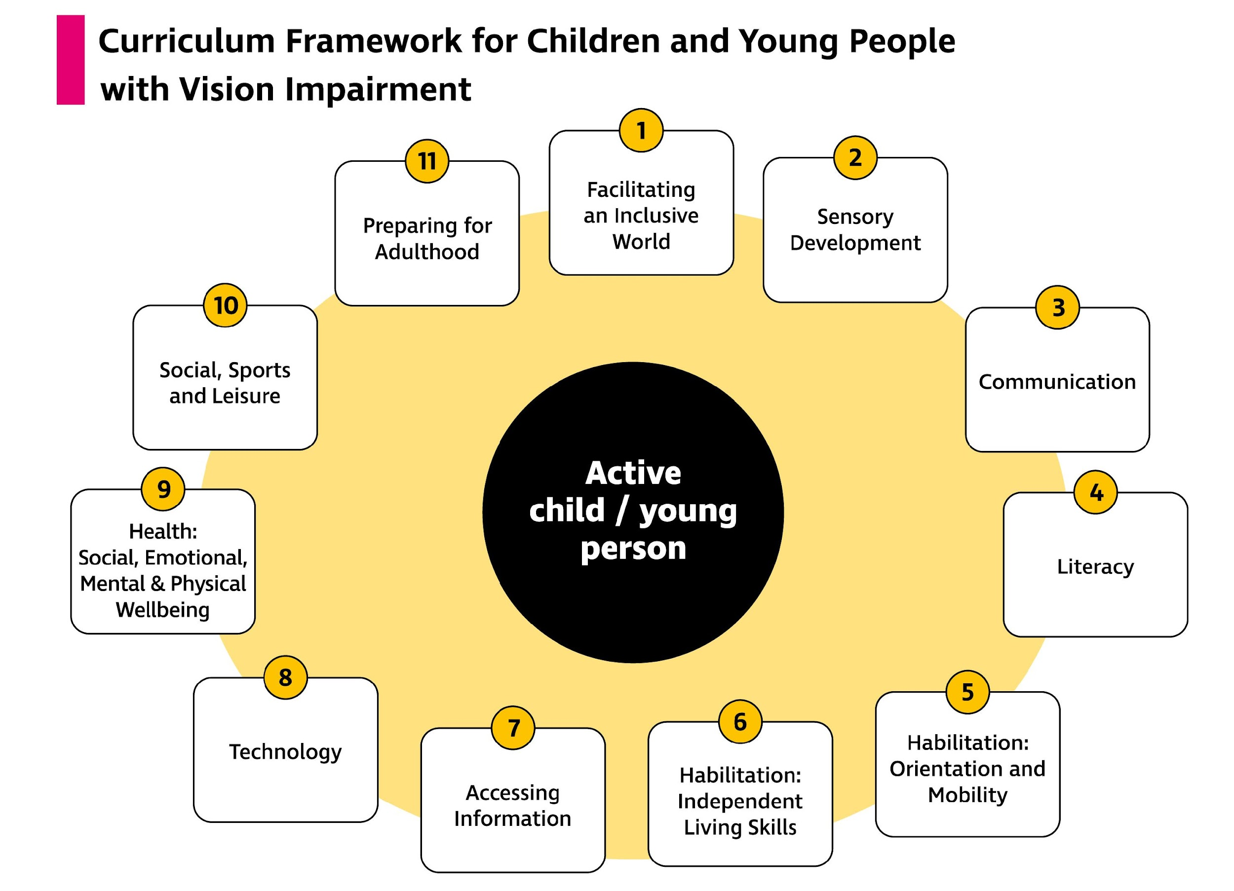
Curriculum Framework for Children and Young People with Vision Impairment (2022, p.15)
Notes:
Speaker notes
Provide a brief overview of each area.
Make the point that not all children and young people will require intervention in all areas.
Also explain that whilst the diagram shows the areas as being quite separate, they overlap/interrelate. Give some examples of intervention strategies for select areas and seek examples from audience perhaps?
Draw attention to the active child/young person at the centre of the diagram: an active participant in their education who can express a viewpoint on their education/a preference for how they access.

Slide 8
Key Language
Curriculum Framework
↓
Areas of the Framework
↓
Targeted outcomes (Area 1) – focus is changing society/attitudes/creating an enabling environment and removing social and physical barriers (access to learning focus)
↓
Targeted interventions (Areas 2-11) – skills based/specialist interventions/independence (moving towards learning to access)
Notes:
Speaker notes
Emphasise the importance of getting the “umbrella” language of the framework accurate: so we talk about the framework, the areas within it and then the outcomes or interventions that might be delivered within the areas.
Explain that underpinning the framework is the “access to learning (A2L)” and the “learning to access (L2A) model [this is the next slide]

Slide 9
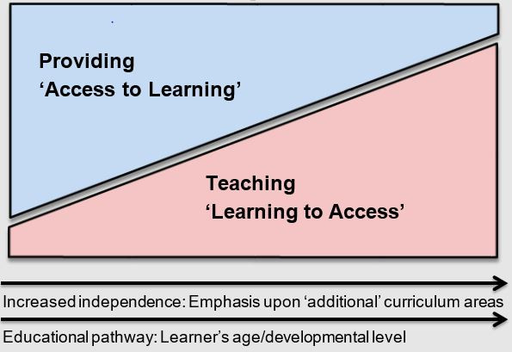
The Learning to Access/Access to Learning model
Adapted from McLinden, M, Douglas, G, Hewett, R, Cobb, R, Keil, S, Lynch, P, Roe, J & Stewart Thistlethwaite, J 2023, Promoting Equitable Access to Education for Children and Young People with Vision Impairment: A route-map for a balanced curriculum. Routledge.
Notes:
Speaker notes
The CFVI is underpinned by the ‘Access to learning /Learning to access’ model which provides a conceptual framework for use of the CFVI.
A2L emphasises a learning environment that allows learners with vision impairment to access a shared or “core” curriculum with their sighted peers, and seeks to ensure that educational access is fair and optimised. An example is the use of large print books or bespoke large print materials with modified pictures for a learner with vision impairment.
L2A recognises that there is a need to teach an additional or specialist curriculum to promote learner independence and facilitate social inclusion and personal agency. It includes specialist interventions. Examples include orientation and mobility training (Area5 of CFVI) and technology (Area 8 of CFVI) [when presenting these example can be customised as appropriate].
Highlight that the model recognises there is a balance between these broad approaches and a progression over time so as to ensure that to whatever extent is possible, the emphasis shifts from support being provided directly to the child/young person (A2L) to them acquiring the particular skills so that they can act and learn more independently (L2A).
Key principles:
Equitable access to education
Developing personal agency

Slide 10
How can the CFVI be used with children and young people with a VI?
Seeks to clarify and define the range of skills that are important to children and young people (CYP) with a vision impairment (VI).
It provides CYP with an understanding of outcomes that they can work towards linked to the specialist curriculum.
It supports an understanding of their potential and this supports their emotional wellbeing and sense of agency.
Notes:
Speaker notes
Emphasise the need to discuss the CFVI/skills to be taught/acquired with the child/young person to promote understanding and define the skills important to them. Children and young people with vision impairment will have a range of experiences and insights into what helps or hinders their access to education, independence and social interaction. Their views should therefore be sought and they should be encouraged and supported to advocate for themselves, as appropriate to their age or stage of development. They deserve to know what their education is trying to achieve for them and to have voice in this.
The framework provides young people with vision impairment with an insight into some of the ways they can do this – how they can access information and use technology, move about as independently as possible, interact confidently with others and have an understanding of their own potential.
Such understanding of their own potential will also support their emotional wellbeing and sense of agency.

Slide 11
How can the CFVI help parents/families?
Offers a shared vocabulary between families and professionals.
Helps families understand the pathways of support for their child.
Provides an increased understanding of areas of focus for their child’s learning and the long-term objectives of professionals.
CFVI Parents Guide is available through the RNIB website (External).
Notes:
Speaker notes
A shared vocabulary or common language enables parents, vision impairment education professionals, classroom teachers, teaching assistants and other professionals to communicate more effectively when discussing a child or young person’s support needs.
An understanding of long-term objectives will maximise CYP’s independence, both in education and the wider world, in preparation for adulthood; serve as a guide for parents when engaging with their child’s activities at home as they learn new skills and knowledge.
The Parents Guide was written by parents of CYPVI. The Guide launched in Spring 2023 and can be accessed from the CFVI resources on RNIB website.

Slide 12
How can the CFVI help other professionals?
Allows the range of professionals (education, health, social care) working with CYP with VI to set and work towards common outcomes relating to L2A/A2L using the language of the CFVI.
Promotes a shared understanding of the skills required.
Promotes the embedding/reinforcement of these taught specialist skills in school and wider life.
Notes:
Speaker notes
Many professionals will be involved in promoting the inclusion of children and young people with a VI: e.g. QTVI, Qualified Registered Habilitation Officers (QRHS) or Rehabilitation Officers, Visual Impairment (RoVis), specialist teaching assistants, resource technicians (or tailor this list to your provision).
Their objective is to ensure inclusive practice (through promoting ‘access to learning’ approaches), whilst also ensuring that individuals are provided with the necessary skills and opportunities to become as independent as possible (through targeted ‘learning to access’ approaches i.e. the delivery of teaching in some or all of areas 2-11 of the framework).
(As) specialists (we) have important oversight of the impact on development and learning of children and young people person with VI. (We)/they support all those around involved in their education. (We)/they will also be involved in directly teaching specialist skills - for example, mobility and orientation, independent living skills, braille literacy, technology and communication (or customise the list to what you will be teaching a specific pupil – as appropriate).
Those who work with the child/young person on a daily basis are crucial in ensuring this specialist work is embedded/incorporated every day. So it’s important that you understand what specialist skills are being taught and the role you have to play in embedding and reinforcing them.

Slide 13
What resources are available?
The Bookshare Hub hosting resources to support the delivery of the CFVI is available from RNIB (External)
The CFVI provides a list of targeted intervention approaches: Curriculum Framework for Children and Young People with Vision Impairment | RNIB
Notes:
Speaker notes
These links will provide further information about the framework and the resources that support it. Links were current/working at the time of writing. However, prior to delivering training, please do check them as web addresses can change.
Time permitting you could click on links and show the audience – with a focus on the Bookshare Hub – which would fulfil objective 2 of the training as stated on Slide 3
Presenters may wish to view some of this content in advance and show, for example, extracts of videos that may support their delivery.

Slide 14
References
Douglas, G, McLinden, M, Ellis, L, Hewett, R, Hodges, E, Terlektsi, E, Wootten, A, Ware, J., Williams, L 2019, A Rapid Evidence Assessment of the effectiveness of educational interventions to support children and young people with vision impairment. Welsh Assembly Government.
Hewett, R., Douglas, G., McLinden, M., James, L., Brydon, G., Chattaway, T., Cobb, R., Keil, S., Raisanen, S., Sutherland, C., Taylor, J., (2022) Curriculum Framework for Children and young People with Vision Impairment[CFVI]: Defining specialist skills development and best practice support to promote equity, inclusion and personal agency. RNIB
McLinden, M.. Douglas, G., Hewett, R., Cobb, R., Keil, S., Lynch, P., Roe, J., Thistlethwaite, J., (2023) Promoting Equitable Access to Education for Children and Young People with Vision Impairment: A Route-Map for a Balanced Curriculum. Routledge.
.

