Slide 1
Case Study: Gemma

Slide 2
Gemma, 39
Has a hereditary disease called optic atrophy and has been partially sighted since birth
Primarily travels by bus
Regularly takes taxis - tends to pre-book as she doesn’t feel confident waving them down
Happy to walk places independently
Travels on trains but often with company
General travel behaviour:
Things that help:
‘Seeing AI’ – a free app that narrates the world around you - Gemma uses it to hover over information
The Morebus app – not perfect as she can’t zoom in and text is not big enough but uses it for planning purposes
Family support helps, especially accompanying her on different journeys and providing her with information or supporting her to navigate
Interactive taxi app - can use voice notes and they tell you when they’re coming and can also edit your booking
Cane - Gemma uses it on longer journeys to make people more aware of disability
“People know that a stick means that I have bad eyes and might be more willing to help.”
Spinner at bottom of traffic lights with a sound – lets her know when to and when not to cross a main road

Slide 3
Pain points/challenges:
Staff
She flags down every bus as she is unable to get see which number is approaching on the dot matrix board. She often gets into confrontations with bus drivers who get annoyed
Information
Small timetables at bus stops (and sizing of wording in general)
Inconsistent audio announcements (e.g. not sharing notices about train delays)
“Drivers get angry if I flag down the wrong bus – especially if it’s running late.”
Other customers
E-Bikes and e-scooters that travel silently can be frightening
‘Don’t sit here’ signs were put on seats on buses during pandemic which led to negative interactions with other passengers – huffing and tutting etc
The built environment
Roads with blind corners – makes it unnerving to cross the road when walking
Uneven surface pavements near to her house – particularly bad around tree trunks (makes it easy to trip up)

Slide 4
Accompanied journey in detail:
Planning:
Gemma usually plans her journeys in advance. She will look at travel websites and use her travel apps, or she may ask her husband to write out an itinerary for her for less familiar and longer journeys.
Walking to bus stop from home
Straightforward as Gemma has done this journey a number of times – some frustration at the state of the pavement which was very uneven around tree roots (see photo) – makes it very easy to trip
At bus stop
Frustration at the size of the timetable in the information board display. She was unable to see which bus was coming via the electronic display. She would have just hailed any bus if she had been alone as she can’t see the bus number
Ticket machine
Gemma cannot read the text on the ticket machine screens and relies on staff or other passengers to help her.
Getting to/on train platform:
Found steps quite difficult as the depth was high
Gemma couldn’t read electronic boards displaying arrival times of trains – the train was delayed but she only discovered this after asking a member of staff

Slide 5
Accompanied journey in detail continued:
On train:
Always takes a big step to get on/off train
Fairly straightforward until Gemma got to Bournemouth. It was easy to get a seat and there were no interactions with other passengers
Unexpected splitting of train at Bournemouth:
Gemma only found out about this as a train guard walked down the train to let people know – she wouldn’t have known otherwise (no audio announcement or announcement at Pokesdown) so she had to disembark the train and get on again to board a different carriage
Getting off public transport:
Fairly straightforward but Gemma had to take a bit of time to get her bearings on the platform at Poole station to figure out which way to exit
Walking to our destination (Costa Coffee by Poole station):
Fine walking to destination but she felt quite anxious crossing a pedestrian crossing along a major A road. Gemma appreciated eye-level traffic lights
Wrap up and reflections:
“It’s amazing how disruptive a journey can be. 1.5 hours for a 6-mile journey!”

Slide 6
Summary of disruption:
Journey ended up being much more stressful than Gemma expected
Ticket buying issues
Train delay of 8 minutes at Pokesdown
Unexpected splitting of train at Bournemouth during journey
Reflections and ideas for the future:
Accessible transport means…
Short term priorities:
Increase size of text on signage
More help points in stations or designated areas where staff will be present
Better provision of audio information
Audio information at bus stops would be valued
Long term priorities:
Apps providing alternative route suggestions if something goes wrong
“That I’m able to live a normal life!”
She would use it more; would be more sociable; would go to office and would save on petrol costs! (free bus pass)
The look and feel of buses would be bright, bold, big
Clear audio announcements (especially if services are late or disrupted) –
Non-negotiable factors are: reliability of information, live updates, making timetables bigger at bus stops and options for alternative modes on travel apps
“It’s the independence that I don’t have. I hate relying on others.”

Slide 7
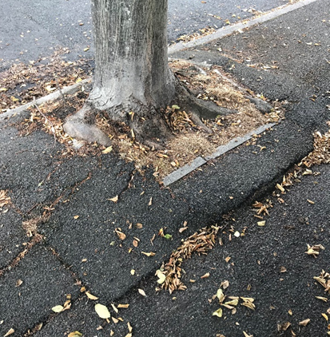
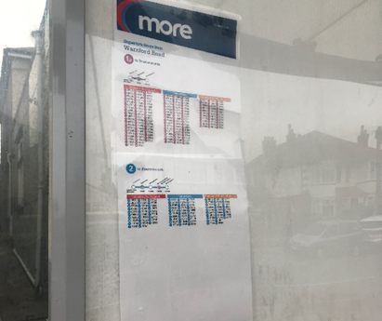
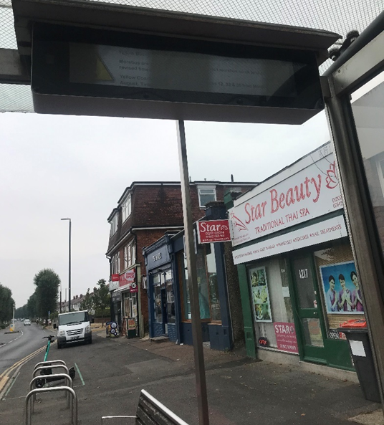
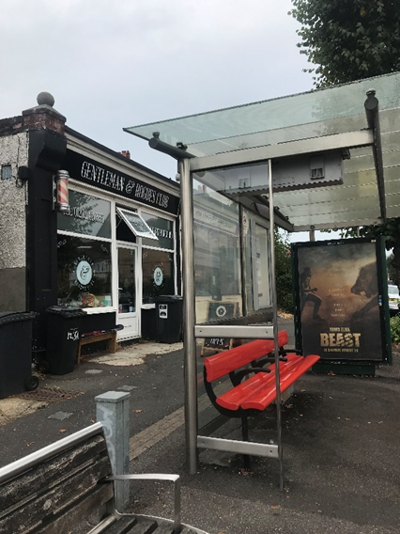
Journey photos:
Uneven pavements means that it’s very easy to trip up – even worse when it’s dark
Tiny font on bus shelter timetable (near home) is impossible to read – huge information board with this printed out very small in a corner
Impossible to read the dot matrix board showing which buses were coming and when – Gemma has to flag down every bus and hope that the right one will come eventually

Slide 8
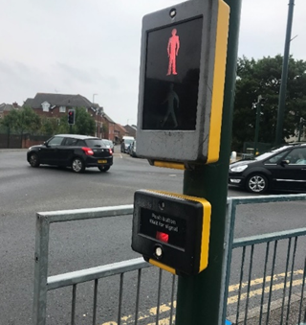
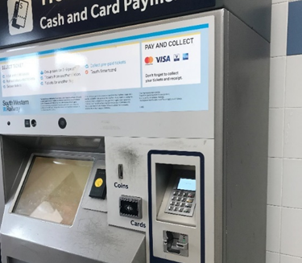
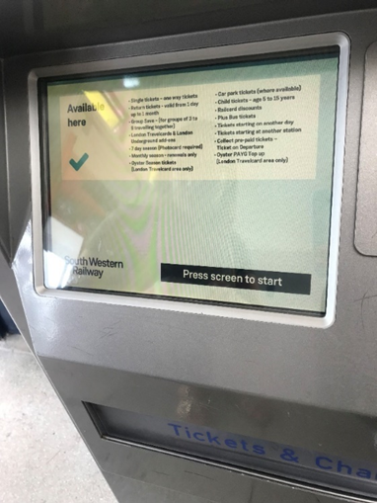
Journey photos continued
Crossing point push button works well here as it’s at eye-level
Ticket machine at Pokesdown Train Station – Gemma couldn’t read the text on the screen at all she ended up accidentally buying one which said that it was an ‘Evening Out/Return’ rather than a daytime one
There was a member of staff in the ticket office who we could query this with and he said that it was fine but clearly very confusing when we were travelling in daytime!
“He seemed quick to get on his lunch break!”
If the staff member hadn’t been there, Gemma would just have had to guess which ticket option was the correct one for a return from Pokesdown to Poole

Slide 9
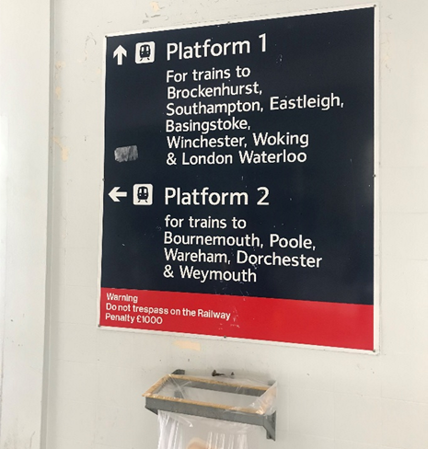
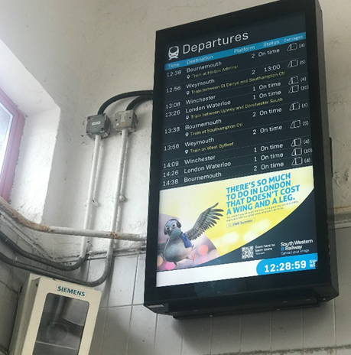
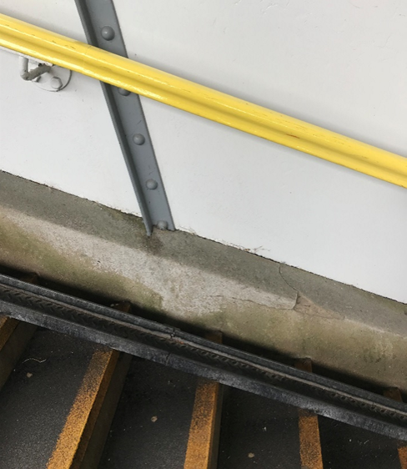
Journey photos continued
Departure board is too high up at Pokesdown Train Station for Gemma to see – eye-level boards with large font (like platform ones below) are much better as she can see the displayed information
These platform information boards at Pokesdown Train Station are best-in-class. They are at eye level and use large font
Brightly coloured handrails are appreciated – especially in the darker winter months when it is easier to slip
Train to Poole was delayed – Gemma nearly got on the wrong train as she couldn’t read the information display

Slide 10
Case Study: Ian

Slide 11
Ian, 67
Age related macular degeneration developed over 2 years ago.
Primarily uses both buses and trains
Familiar with route and able to travel independently
Happy to walk in familiar surroundings
General travel behaviour:
Things that help:
The National rail app
A symbol cane to signal to others
Ian uses the screen at the train station to indicate train and platform
Pain points/challenges:
Information
The ticket office departure screen is difficult to see and read as it is too small, so often Ian must go to the ticket office window for information
The dot matrix boards in carriages are not always easily accessible if in priority access. It might be behind him and directly above his head.
The built environment
Getting off the train can be challenging due to the gaps between the platform. So, Ian must go slow to ensure he has his grounding

Slide 12
Accompanied journey in detail:
Planning:
Ian uses the National Rail app to plan, calls the station to double check with staff the trains are running smoothly. He does this the day before travelling
Walking to train station from home
It’s a 10 minute walk. Ian’s main concerns are crossings, needing to locate the curbs and safe mid points to stop if needed
At train station
Ian again talks to staff at the ticket office - to ensure he knows the platform and train time and he buys a physical ticket at the ticket office
At the platform
Ian is familiar with the stations signage, location and size well thought out. He is comfortable with the dot matrix boards also, the colour contrast allows him to understand the information provided
On transport
Audio announcements are crucial for his ability to travel: to know where he is and whether there are any changes. He opts for the priority access seats with a table which give him extra comfort
Disembarking
Ian knows when to get off because it is the end of the line and listens for announcements. Disembarking Ian uses the handrails and ensures he has stable footing, he also uses his symbol cane for others to get out the way

Slide 13
Response to disruption:
The disruption came on the return journey, with lots going on around Ian, he used his knowledge of the route and conversations with others to safely make it home
Initial train consisted of fewer carriages than expected, and was full
Delays impacted the following trains arrival time (listened for audio announcements)
Sporadic audio announcements en route detailing possible reduced stops on the service (including his destination)
Reflections and ideas for the future:
Accessible transport means…
“Creating visual impairment and mobility impairment accessible transport available”
Short term priorities:
Education on available accessibility apps
Add lighting on steps to show where the steps are. Change the lighting around the open and closed button at the doors for easier disembarking and knowing when the doors can be opened
More legible, larger printable timetables.
Larger and more dot matrix boards
Better reserving of priority access seating
Long term priorities:
Making all stations more accessible for mobility and visually impaired users. Including ramps, more announcements, larger screens, more signage. And more lifts and escalators
Small stations at the moment are just not accessible. They do not have all the features that are necessary: still include lots of steps, small screens and fewer staff

Slide 14
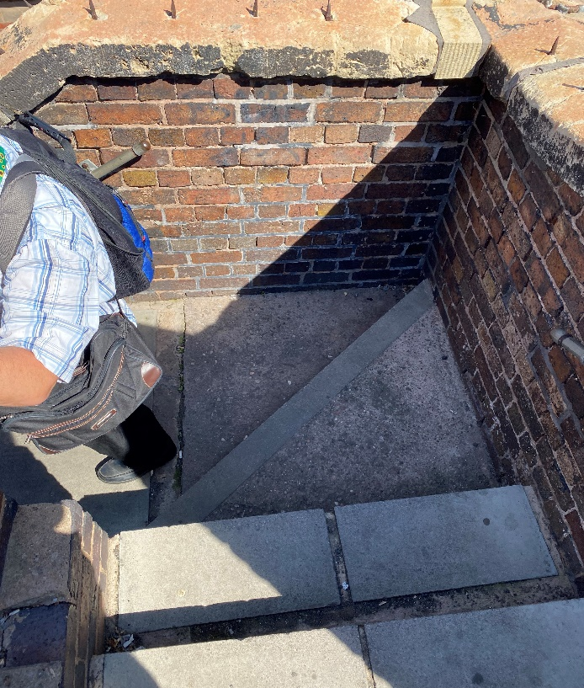
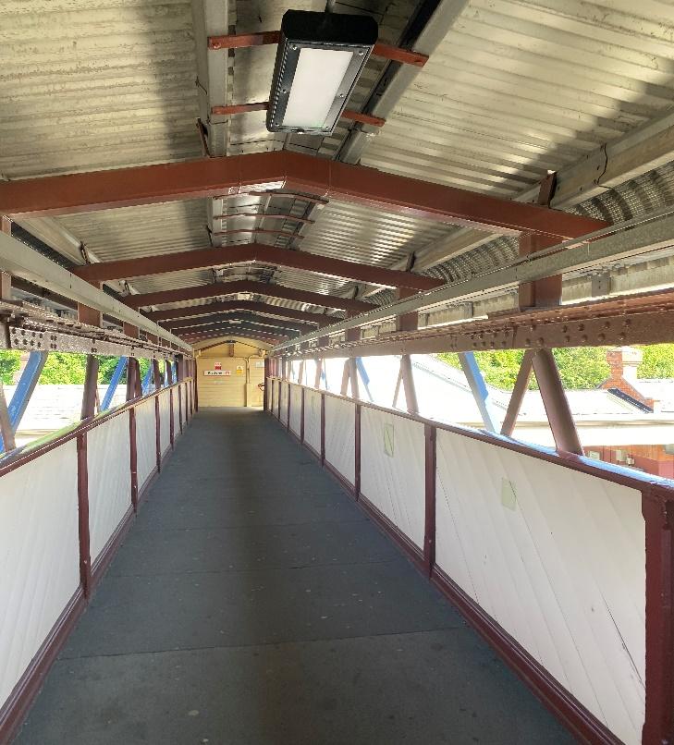
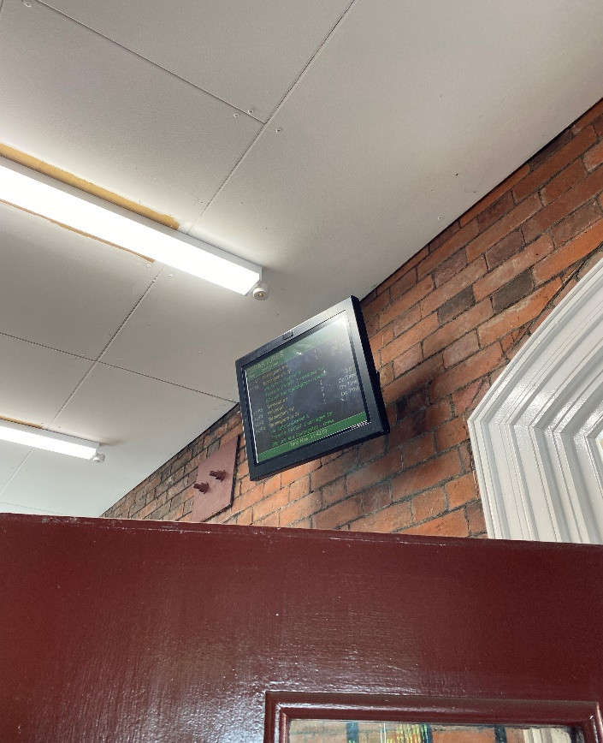
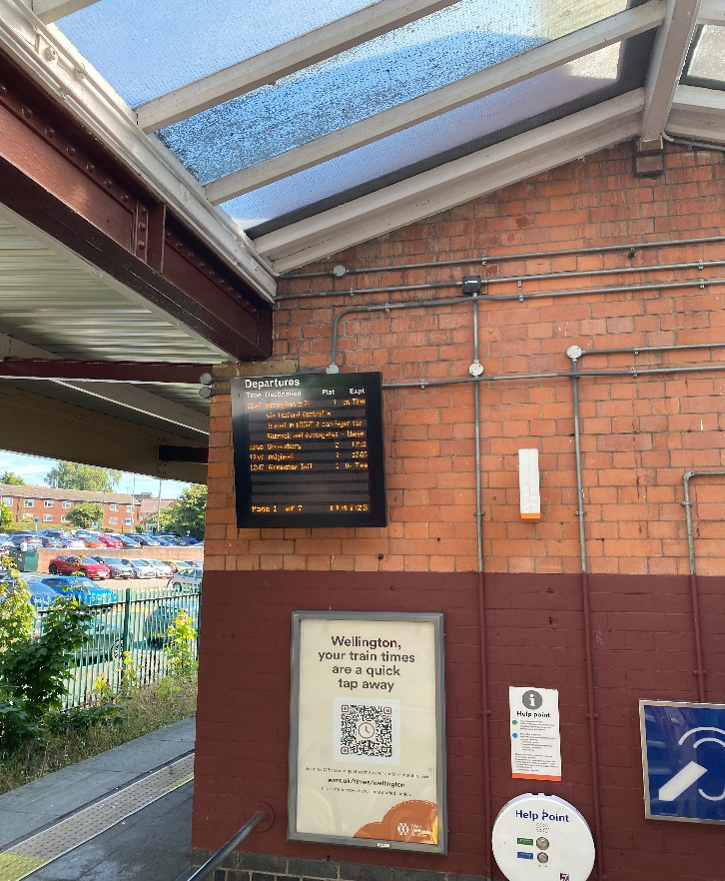
Journey photos:
Ian uses the handrails when walking down the stairs. Handrails don’t cover the full way round.
The walk from the ticket office to the station is long but Ian walks closes to the walls for support.
The train departure screen is small, high and behind the entrance door. With the dot matrix board, the colour contrast allows him to be able to read and follow along with it at all times.

Slide 15
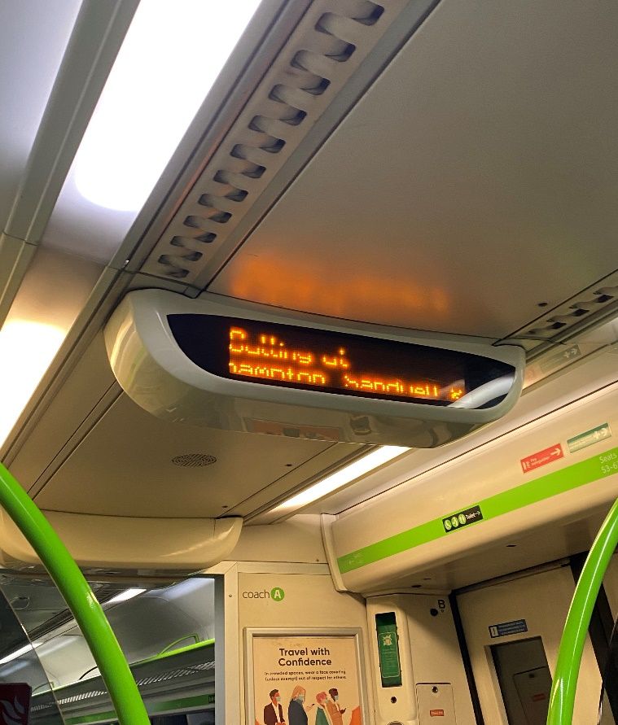
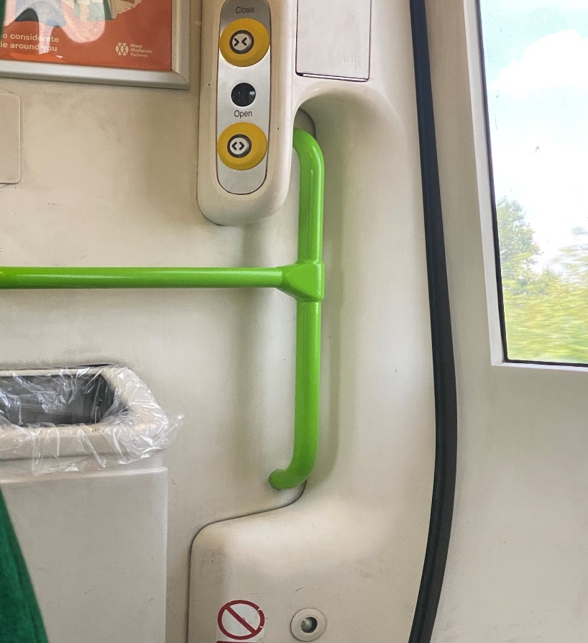
Journey photos continued
When dealing with the disruption, the audio information helped in making a decision as to whether to stay, or leave the train. It is essential for Ian to hold the handrails when disembarking, this allows him to remain stable and ensure a smooth getting off of the train.

Slide 16
Case Study: Steve

Slide 17
Steve, 41
Steve has a combination of macular degeneration and diabetic retinopathy. He has lost sight in his left eye, and has limited vision in his right eye although his condition not immediately visible. He also has limited sensitivity in his feet
Generally uses the train and bus
Travels roughly 3x a week and is familiar with journey
Happy to travel independently
General travel behaviour:
Things that help:
His knowledge and previous experience; Previously worked for a company that manages the Overground, making him extremely familiar with the network
Pre-planning and giving himself extra time
His mini telescope helps him see things in the distance more clearly (e.g. bus boards, buses coming into stop)
Bus times app, google maps, TfL apps which he enlarges on phone; also finds the Cross-Country app very easy to use and with good display. He or his wife checks them at home on his iPad or laptop beforehand
Overground is generally much better than the bus and tube (more spacious, more ramps, doors of OG are more level with the platform)
When travelling with his daughter, she points out seats. Otherwise, he stands in the middle of the bus

Slide 18
Pain points/challenges:
Staff
Staff often not there and when they are, do not want to/cannot help [has knowledge that management make staff prioritise business KPIs instead of helping people]
Information
Signage is difficult to read (esp. dot matrix boards are blurry)
The built environment
Generally difficult to navigate – doesn’t have depth perception – cannot gauge how high drops are when getting of the bus
Other customers
The general public, other passengers can be rude. Also, his concern that others may be rude – fear of an unwelcome reaction/ judgment from others

Slide 19
Accompanied journey in detail:
Planning:
Knows the route by heart, he already knew the bus times when we met. Knew there were 2 buses we could take
Because of strikes he had asked his wife to check if there were any disruptions to the journey on their laptop
Walking to bus stop from home
Has no issues when walking to the bus stop
At bus stop
Used his mini-telescope to look at the board and could see when next bus was due. Also used it to check the number of approaching bus.
On Bus
Getting on the bus Steve angled his foot (by moving his ankle) to check the height of the step before getting on.
Steve doesn’t have feeling on sole of feet but with this movement, it’s the angle of the ankle that helps him.
Steve walked to the middle section of bus, he likes to be close to doors and this area as they are more spacious.
Steve knew he was approaching the stop due to announcements but also from his familiarity of journey.
Getting off
Stepping off the bus is a “stumbling block” as he cannot gauge the height of the drop. To help he holds on securely to handrails and walks off slowly.

Slide 20
Accompanied journey in detail continued:
Crossing the road from bus stop
Steve walked slowly and carefully when walking to the train station.
At Harringay Green Lanes Overground station:
There was a natural ‘disruption’ en route, he was able to move well and called out strengths in the environment:
Steps have a thick orange lines which stands out
Good solid, orange handrails
Less of a step into train than onto bus
Unexpected 30 minute delay at on platform
The delay was a minor inconvenience, Steve was able to wait and follow audio announcements to get the necessary train.
Got onto the train making sure to be sat in the carriage closest to the station elevator at Blackhorse Road Station
Overground Blackhorse Road Station
Steve knew where the elevator was, easily made his way there
Rest of the journey
A smooth walk to the bus stop, the bus and knew the stop to get off at.
On final bus journey
Steve explained there are 3 Co-ops on the bus route, he can see enough of them due to the blue colours standing out. From this, his familiarity and the announcements he knew where to get off

Slide 21
Response to disruption:
Journey had an unexpected but ‘natural’ disruption, a 30 minute delay at Harringay Green Lanes Overground station
Caught Steve by surprise because as part of his routine, he checked for delays before leaving for journey
Waited on the platform and listened out for announcements whilst waiting
Reflections and ideas for the future:
Accessible transport means…
“People recognising that there are disabilities that you can’t see. No judgement and more understanding”
Short term priorities:
Larger staff presence
Bus to lower the platform when disembarking as a default
Larger signage for entry/exit, card readers, toilets etc.
More staff training on accessibility needs
Bus times and other digital screens to be LCD vs LED
More audio announcements
Long term priorities:
Announcements on loop regarding closest step-free access
Dedicated carriages on trains for those with accessibility needs

Slide 22
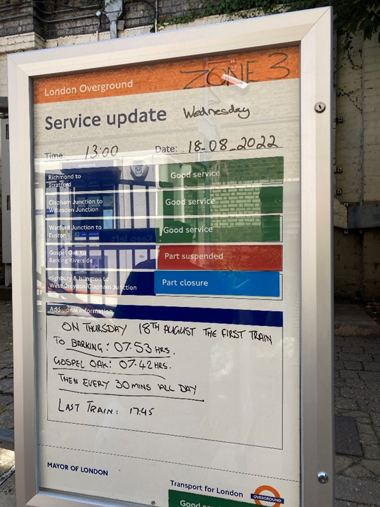
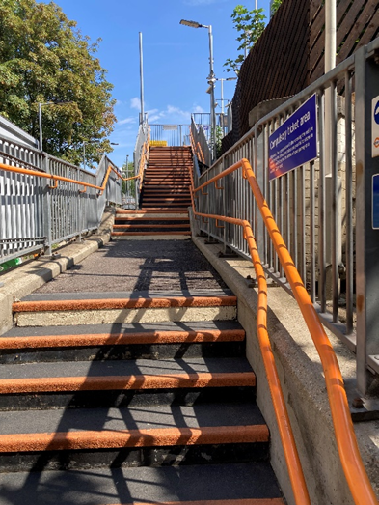
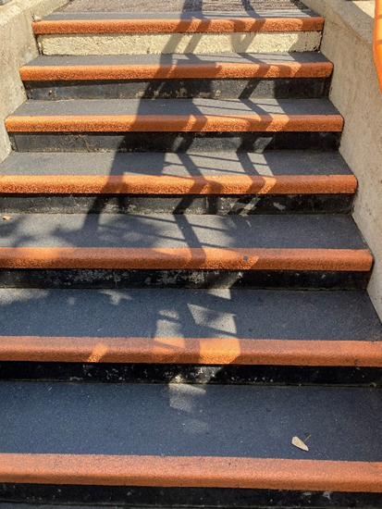
Journey photos
Likes: The thick orange lines on steps are easy to see. Handrails also stand out
Unexpected 30 min wait for Overground at Harringay Green Lanes

Slide 23
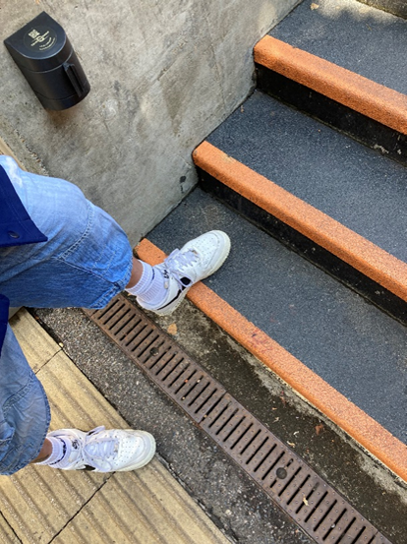
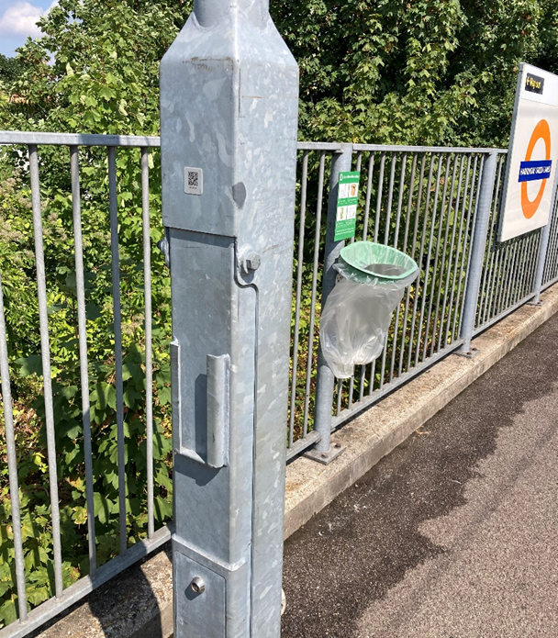
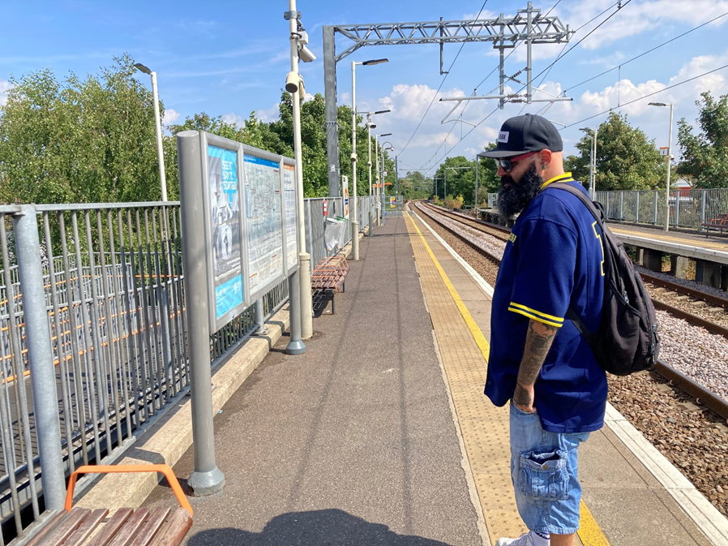
Journey photos continued
Angling of ankle to determine height of steps (does the same thing when stepping onto the bus). The angling of ankle is key because he doesn’t have feeling on the sole of his feet. This movement does not work for disembarking on stepping down from buses and trains though
Obstruction on platform and the grey colour does not stand out/ blends in with its surroundings (grey fence)
Steve on the platform

